Slide 1
OT & ICS – Cyber security
Operational Technology and Industrial Control systems

Slide 2
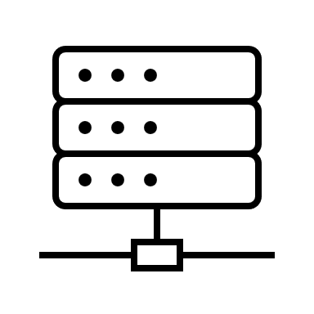





















Purdue Model for OT & ICS
Web Servers
Email Servers
Internet
LEVEL 5
Edge Firewall
Internet DMZ
Remote Clients with MFA Tokens
Cloud / SaaS Apps
IT
LEVEL 4
Corporate Workstations
Corporate Servers
Enterprise Zone
SIEM
Firewall
Security Operation Center
LEVEL 3
Historian, DNS, DC, AV, Remote Access
Site Operations Control and
ICS-Demilitarized Zone
(DMZ)
Sensor
Site Production Control Systems
Firewall
Core Switches
Firewall
Firewall
LEVEL 2
Line Operator / Engineering Workstations
Line Operator / Engineering Workstations
Supervisory Workstations
Area Supervisory Control
OT
Sensor
Access Switch
Sensor
Access Switch
Sensor
Access Switch
LEVEL 1
Building Controllers
/ NVRs
Control Network
PLCs / DCSs
PLCs / RTUs
LEVEL 0
Sensors /
Actuators
Sensors /
Actuators
IIoT / IoT Devices
Field Devices

Slide 3
Defence
Commercial Facility
Chemical Plants
Railway
Industry Segments
Aviation
Manufacturing Plants
Oil Refineries
Ports
Shipping
Energy – Electricity Grid
Nuclear Power Stations
Satellite
Telecom
Energy – Gas Supply Grid
Mining Facilities
Wind Turbines
Healthcare
Water Supply
Water Treatment Plants
Smart City System
Road & Transport
Dam
Pharmaceutical plants
Connected Cars

Slide 4
OT & ICS LAB
Purpose:
Researcher to experiments safely and evaluate security-related scenarios
Industrial cybersecurity training in critical infrastructure
Upskill IT cyber security professional to be OT environment aware
OT engineers training for cyber security
Test bed for physical infrastructure owner and operator to test and train on:
Risk assessment in industrial environments—Security levels in an automated industrial environment
Secure configuration of ICS–SCADA—Integration, diagnosis, analysis and anomaly detection for ICS
Design and implementation of secure industrial networks—Segmentation and protection of industrial networks: switches, routers and industrial firewalls
Network vulnerability assessment and incident detection—Identification of vulnerabilities in industrial networks devices
Use of Intrusion Detection Systems (IDS) and Intrusion Prevention Systems (IPS)
External access: virtual private network (VPN) configurations, RBAC etc

Slide 5




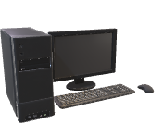
Lab Architecture
Virtualization of hosts
Supervision network
Field network
Control network
ERP
Management
network
Virtual Servers
Security experiments
Reconfigurability of network architecture
Infrastructure switches
Internet
Network attack manager
Firewall
SCADA
Historian
DCS
Workstation
Gateway field protocol – TCP/IP
Lab Router
Different secure automation schemas
Monitor system
Identification and
analysis of
vulnerabilities
PLC
Acquisition of data
Traffic Logger
Database Server
Sensor
Sensor
Actuator
Acquisition of security-related data (SIEM)
IT-OT environment, Several communication protocols, different critical infrastructure domains, Real-life equipment

Slide 6






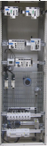
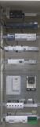
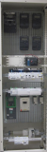
Common Services
10.0.X.0
Level 4
Network (IT)
Corporate network
10.X.3.0
Corporate
Network
Domain Server
Lab Low Level View
Corporate VM
(MES Software)
Domain Server
Switch IT
ERP/BI
Hosts virtualization
VM Corporate Client SCADA Client
Domain Server
VLAN: 10.X.3.0/24
Router/Firewall
VCenter
Level 3
DMZ
DMZ Network 10.X.2.0
Data analysis
SCADA Web Server
Spark
SCADA Web Server
Switch
Web Services
Web Services
Python
Router/Firewall
Level 2
Network (OT)
Supervision network
10.X.1.0
Web Services
SCADA Server
Data acquisition
Industry
SCADA
Building
SCADA
Historian Server
NAS
Energy
SCADA
OPC Server
Database
Switch
Switch
Switch
VLAN: 10.1.1.0/24
VLAN: 10.2.1.0/24
VLAN: 10.3.1.0/24
Wireless Gateway / Router
Client SCADA
Zabbix
Level 0 – 1
ISA 95
Firewall
Firewall
Firewall
Control Network
10.X.0.0
Network architecture
Industry
Switch
Building
Switch
Energy
Switch
Firewall IPS/IDS
System Configuration
Ansible
OPC Servers
PROFIBUS
MODBUS
PROFINET
FIELDBUS
CANOPEN
ETHERNET/IP
KNX
DALI
MODBUS
LONWORKS
X10
BACNET
DNP3
IEC61850
MODBUS
ION
LoRaWAN
ZIGBEE
NB-IoT
WIFI
802.11G
Security tools
Qualys
Gateway configuration
SIEM
Network analyzer
Kali Linux
Industry Cabinet
VLAN: 10.1.0.0/24
Building Cabinet
VLAN: 10.2.0.0/24
Energy Cabinet
VLAN: 10.3.0.0/24
Wireless Sensor System
VLAN: 10.4.0.0/24

Slide 7
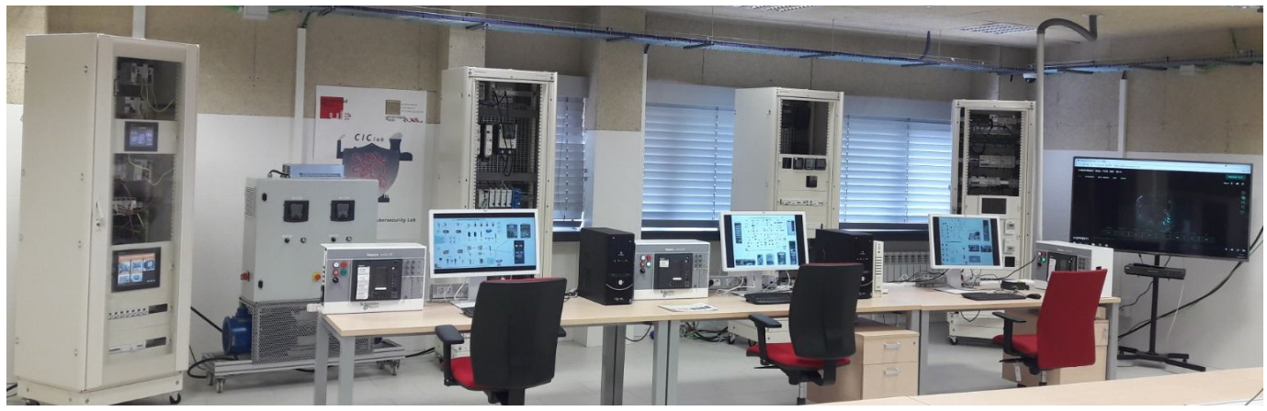
LAB Room

Slide 8
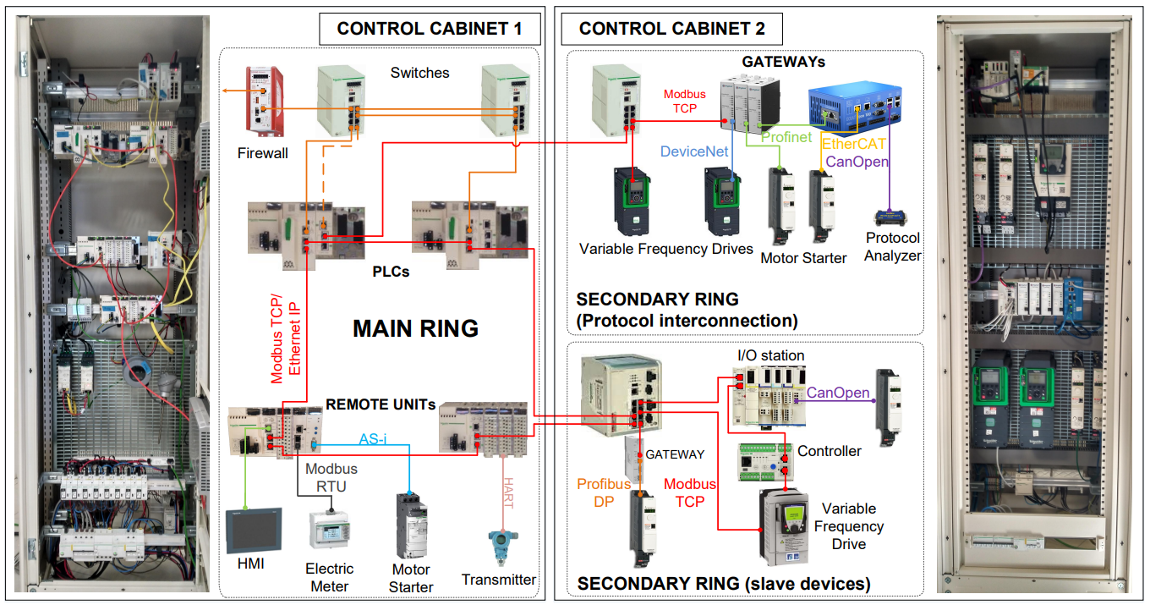

Slide 9
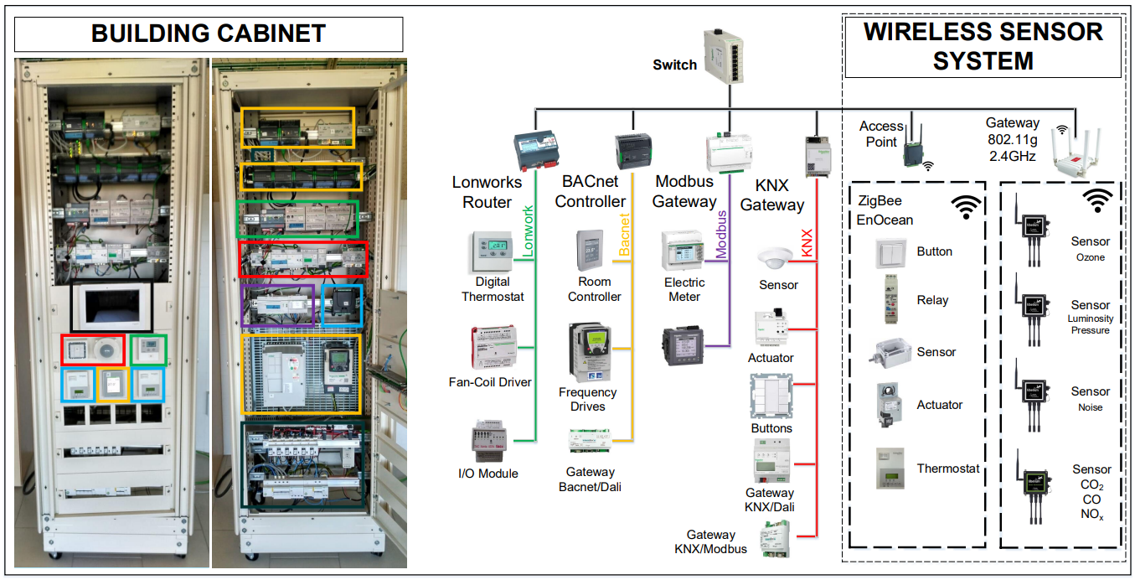

Slide 10
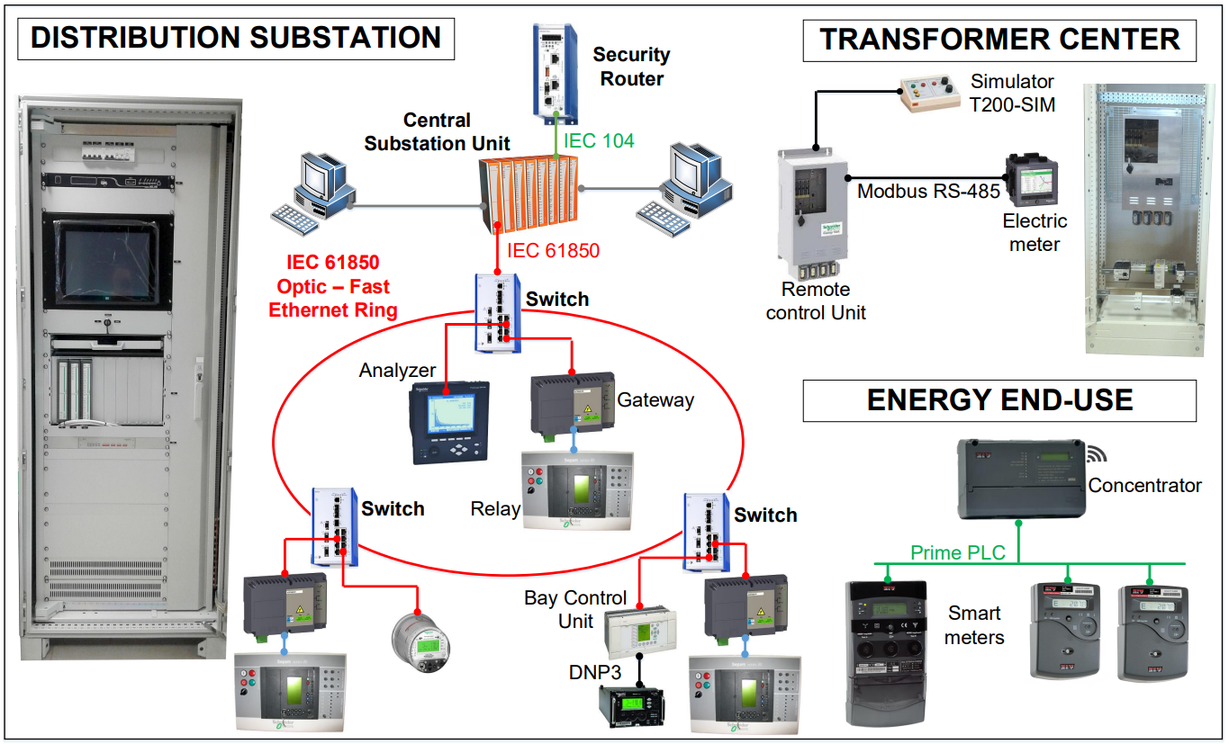

Slide 11
SANS OT/ICS Training Setup

Slide 12
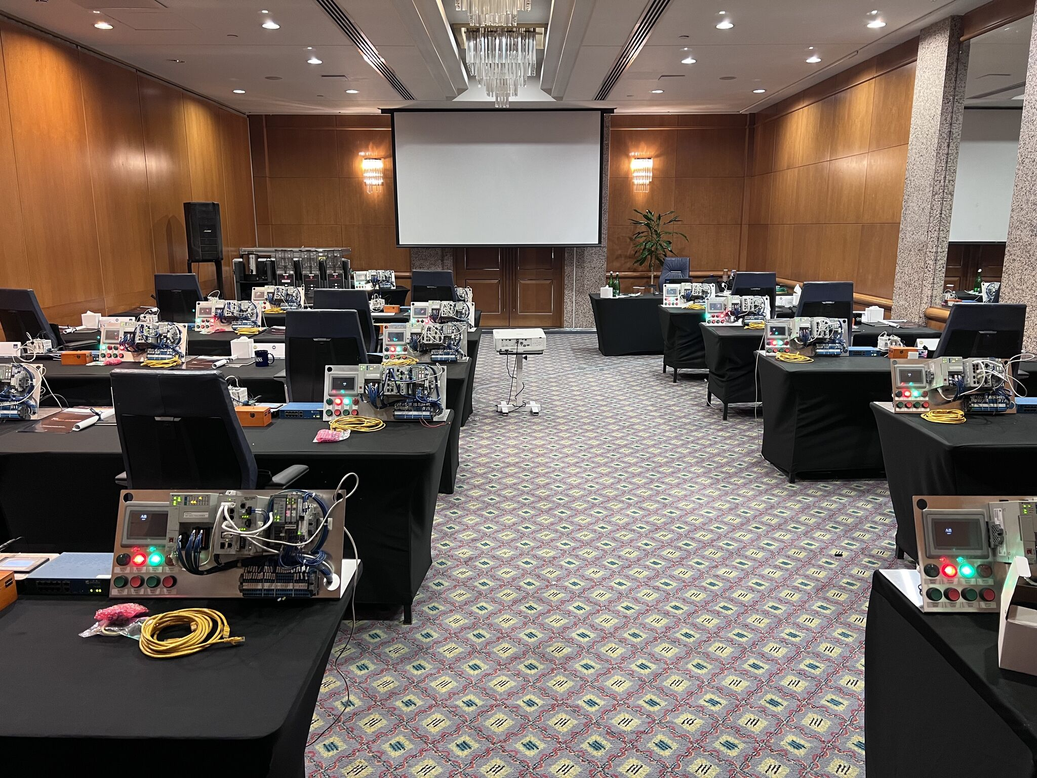

Slide 13
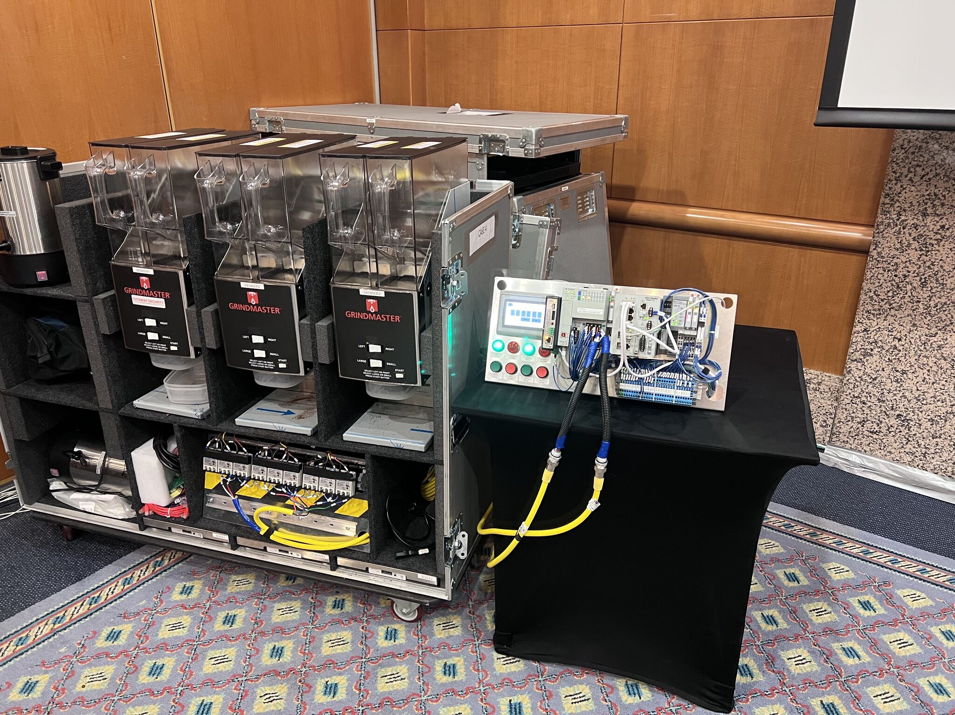

Slide 14
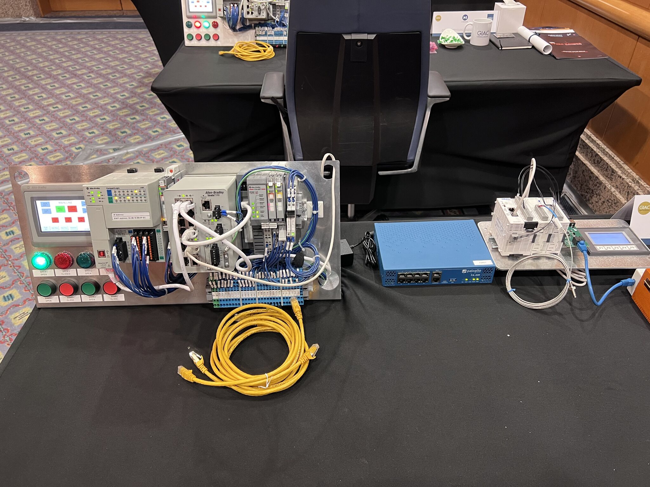

Slide 15
LoRaWAN

Slide 16
